Slide 1
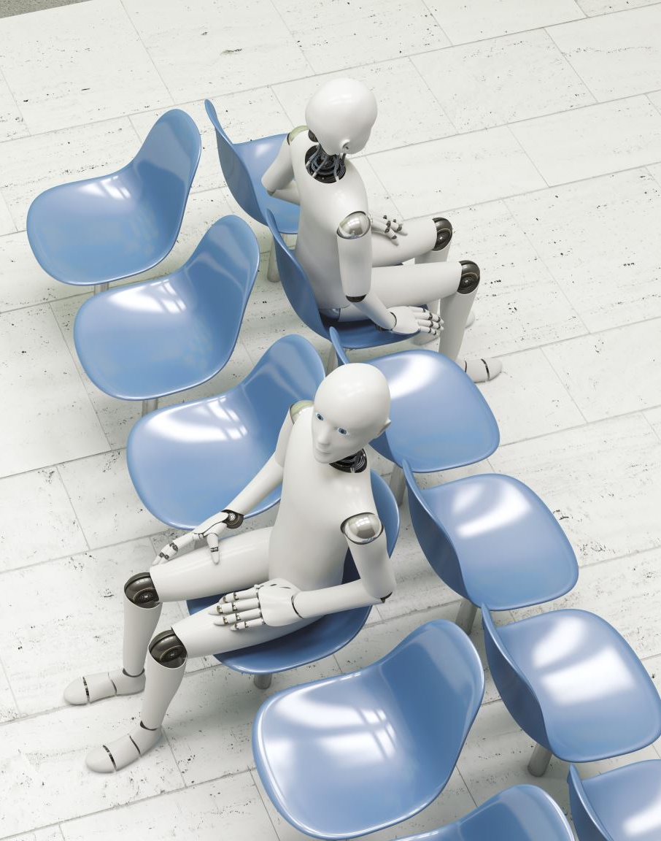
Facility Wait Times
Healthy Co
Note: clients typically have their own template that we use for an engagement, so you won’t have to decide on colors, slide backgrounds, cover page illustrations, etc., but feel free to do so if you wish to practice

Slide 2
Executive summary
Tasked with uncovering key insights on wait times at facility.
Healthy Co is concerned with correlation between patient satisfaction and wait times in facility.
Nearly 5000 observations used in dataset.
Observations taken from dataset include:
Check-in times
Vitals times (time it takes a nurse to take a patient’s vitals)
Doctor wait times (time it takes for doctor to see patient after
Revenue loss due to wait times
Total visit times

Slide 3
Visualization of the effects on wait times

Slide 4
Best practices for addressing wait times
Invest in Technology.
Check-in systems, pre-arrival confirmations, automated registration.
Training on being a low time-waster and highly responsible at work.
Study on the effectiveness of a facility’s time management abilities.
Are policies, compensation, work satisfaction, or other internal factors causing longer wait times?
Sources: Fierce Healthcare, National Library of Medicines

Slide 5
Next steps
Research technological solutions that could help reduce wait times.
Research third party analysts to research organization’s responsibility for wait times.
Continuous monitoring and improvement.
Set up task force to regularly analyze patient wait times and satisfaction.
Report findings to stakeholders and adjust strategy as needed.

Slide 6
Self-reflection form
Once you are happy with your presentation, read through the presentation checklist, and then record yourself presenting (you won’t submit this recording). Watch the recording, and complete this self-reflection slide. Submit as part of your deck.
What did you do well? What are your areas of strength?
Spoke clearly and with enthusiasm Smiled often Knowledgeable on subject matter Clear and concise
What could have gone better? What are your areas of focus for next time?
Said “um” too many times. Got lost in train of thought

